Slide 1
Week 8 Video 4
Hidden Markov Models

Slide 2
Markov Model
There are N states
The agent or world (example: the learner) is in only one state at a time
At each change in time, the system can change state
Based on the current state, there is a different probability for each next state

Slide 3
Markov Model Example
0.3
0.3
A
0.5
B
0.3
0.7
0.4
0.2
0.1
C
0.2

Slide 4
Markov Model Example
0.3
1.0
A
0.5
B
0.0
0.7
0.0
0.2
0.1
C
0.2

Slide 5
Markov Assumption
For predicting the next state, only the current state matters
Often a wrong assumption
But a nice way to simplify the math and reduce overfitting!

Slide 6
Hidden Markov Model (HMM)
There are N states
The world (or learner) is in only one state at a time
We don’t know the state for sure, we can only infer it from behavior(s) and our estimation of the previous state
At each change in time, the system can change state
Based on the current state, there is a different probability for each next state

Slide 7
Hidden Markov Model Example
Behavior
0.1
0.5
0.3
0.3
A
0.5
B
0.7
0.3
0.7
0.4
0.2
0.1
C
0.2

Slide 8
We can estimate the state
Based on the behaviors we see
Based on our estimation of the previous state
What is the probability that the state is X, given
the probability of the behavior seen
the probability of each possible prior state
the probability of the transition to X from each possible prior state

Slide 9
A Simple Hidden Markov Model: Bayesian Knowledge Tracing
Not learned
p(T)
Learned
p(L₀)
p(G)
1-p(S)
correct
correct

Slide 10
Hidden Markov Model: BKT
There are 2 states
The world (or learner) is in only one state at a time: KNOWN OR UNKNOWN
We don’t know the state for sure, we can only infer it from CORRECTNESS and our estimation of the previous probability of KNOWN versus UNKNOWN
At each change in time, the system can LEARN
Based on the current state, there is a different probability for each next state
P(T) of going KNOWN from UNKNOWN
KNOWN from KNOWN

Slide 11
Fitting BKT is hard…
Fitting HMMs is no easier
Often local minima
Several algorithms are used to fit parameters, including EM, Baum-Welch, and segmental k-Means
Our old friends BiC and AIC are typically used to choose number of nodes

Slide 12
Other examples of HMM in education

Slide 13
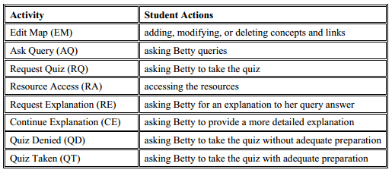
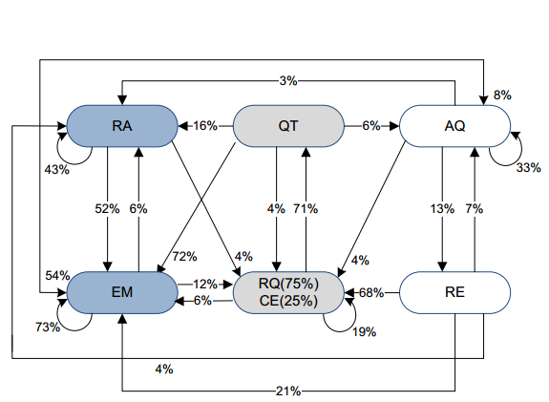
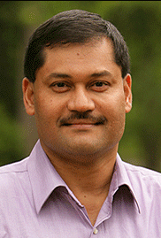
Predicting Transitions Between Student Activities (Jeong & Biswas, 2008)

Slide 14
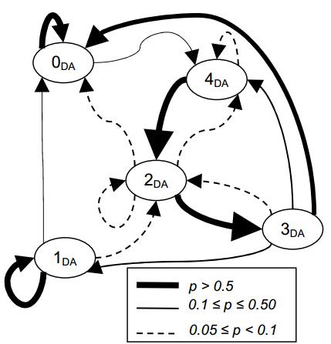


Studying patterns in dialogue acts between students and (human) tutors
(Boyer et al., 2009)
5 states
0: Tutor Lecture
4: Tutor Lecture and Probing
3: Tutor Feedback
1: Student Reflection
2: Grounding

Slide 15
A powerful tool
For studying the transitions between states and/or behaviors
And for estimating what state a learner (or other agent) is in

Slide 16
Next lecture
Conclusions and Future Directions

